Slide 1
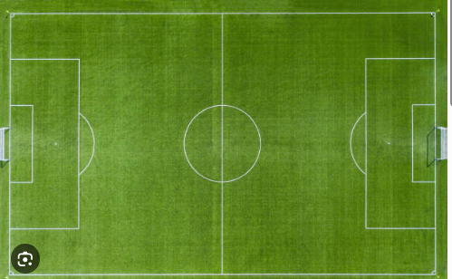
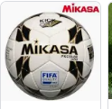
Football Player Performance And Valuation Analysis MOHAMED ALDOSERI
Transfer market and Performance

Slide 2
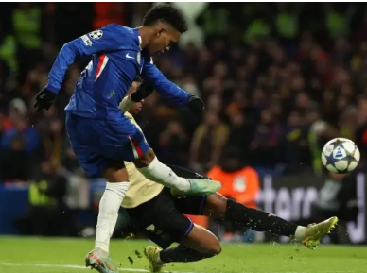





Outlines
Defining The Problem Statement
Aims and Objectives
Contents of The Dataset
Insights
Resolutions
✅
Target Audience
Tools To Be Used

Slide 3
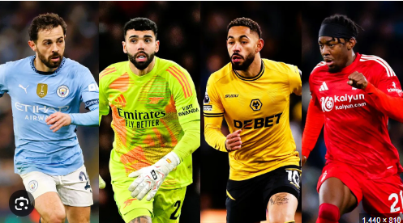

Problem Statement
This study aims to analyze players performance metrics such as appearance, goals+ assists contributions and their relations to market value of players across European top 5 leagues.

Slide 4
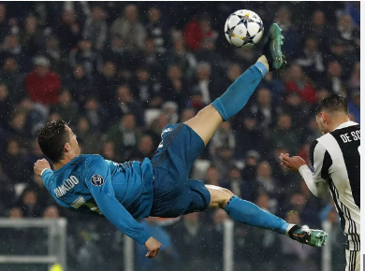
Aims and Objectives
Aim
To evaluate how player’s on-field contributions and appearance translates to player market valuation across European top 5 leagues.
Objectives
Analyze player overall contributions to the game.
Compare players performance and valuation across top 5 leagues in Europe.
Examine on-field positions and goal contributions.
Identify most productive players in terms of value for money.

Slide 5
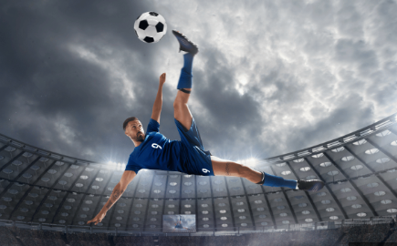
Contents of The Dataset
Football Transfer Market
Features : 23
Leagues: Top 5 European leagues
Time period: 2014–2020
Unique players: 24177
Minutes
400,000+ player market valuations historical records
1,200,000+ player appearance records from all games
1.2 Million Appearances
Assists
Key passes
Yellow Cards
Player ID
Goals and goal Contributions
Market Value

Slide 6
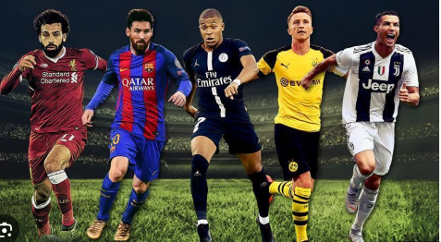
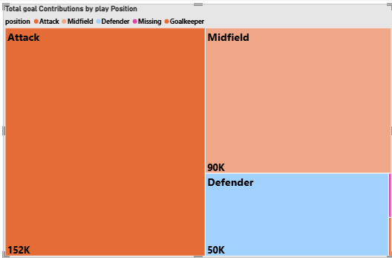
OVERALL GOALS OVERVIEW
Attacking players had the most goal Scored 2014-2022
6

Slide 7

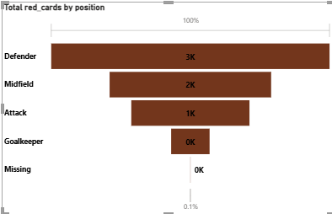
PLAYERS DISCIPLINE
Defenders were the most sent off players 2014-2022

Slide 8
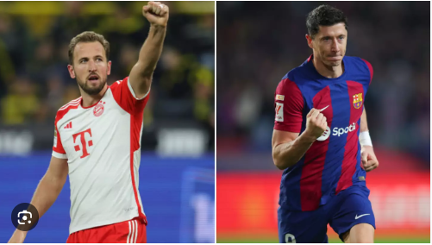
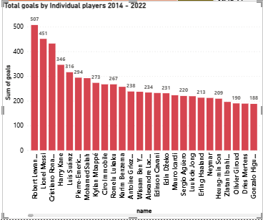
Top Goal Scorers
Robert Lewandoski, Messi, Ronaldo and Harry Kane Sored the most Goals between 2014 - 2022

Slide 9
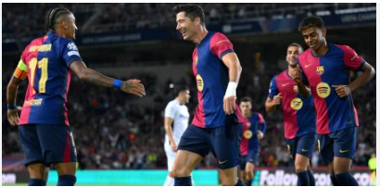
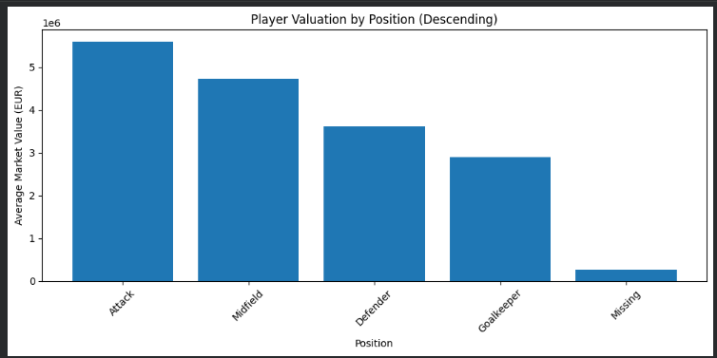
Player Position by Market Value
Attackers have the highest Market value, followed by midfielders
6

Slide 10
Hypothesis and ANOVA
Explained Key Terms
ANOVA (Analysis of Variance)- Used to test significant difference in group means, In this case groups are positions
Sum of Squares (Sum-Sq)- This is the variation in datapoints
F-Value- Ratio of within groups differences
P-value- Probability of the results happening
Sum of Squares Total (SSQ total)- Variation in goal contribution for players across the dataset
SSQ position- Variation in goal contributions for position specific

Slide 11

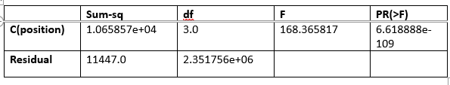
Hypothesis and ANOVA
H0: There is no significant relationship between position and goal contributions per 90
The F(3, 111447) = 168.37 with p < 10⁻¹⁰⁰, are statistically significant
For scouts, this means we reject the null hypothesis, Goal contribution per 90 varies across different on-field positions

Slide 12
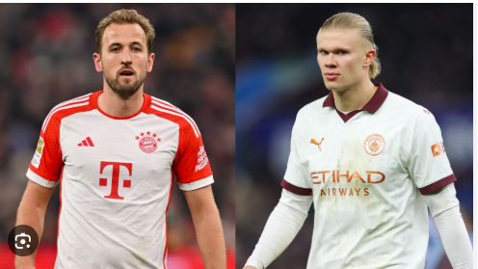
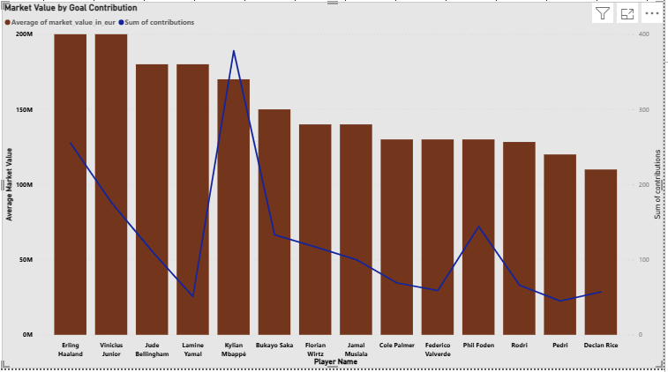
value for money.
Mbappe,Vinicious Jr, Rodri, Haaland and Jude Bellingham tops the list of player value
Goal goal contributions varies, with some less valuable players exceeding their values by contributing more.
6

Slide 13
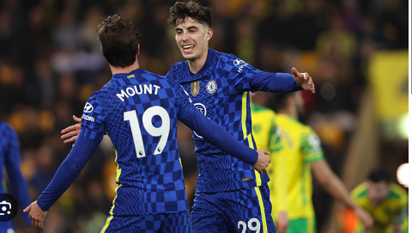
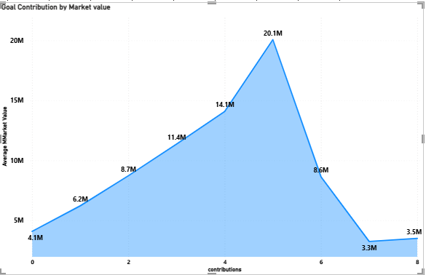
Player Value vs Contribution
Overall goal contribution does not entirely depend on player value

Slide 14
Player Value Predictive Model
Key Terminologies
R-Squared- Proportion of variation of dependent variable(Goal contribution) explained by that the Regression Model can explain
Adjusted R-squared- The corrected R-squared
F-statistic- Tests how the model can explain variability with predictors compared to without.
AIC (Akaike Information Criterion) – Model quality measure, better fitting are shown by lower values
BIC (Bayesian Information Criterion)- Measure model quality but penalizes the complexity.

Slide 15
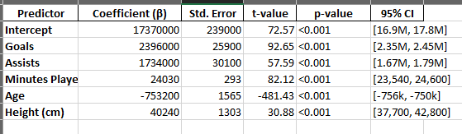
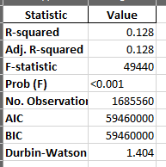
Player Value Predictive Model
OLS Regression:
Goals drive player value, every additional, market value increases by 2,4M Euro
Creativity is a reward also, each assist increases value by 1.7M
Consistency or minute played, regular playing time increases value by 24k
The model can explain almost 13% of player price valuation (R-squared =0.128)

Slide 16
Resolution and Conclusion
Conclusion:
From the ANOVA playing position strongly affects goal contribution
Market value is driven more by a combination of productivity goal contribution, and playing time.
Recommendations
Clubs should use value for money metrics to identify player significance
Scouts should prioritize positional contribution
For Analysts, use a combination of performance metrics with age and playing-time trends

Slide 17
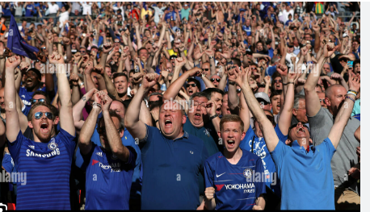
Target Audience
Fans
1
1
Media
2
Researchers & Analysts
3
Football clubs and Scouts
4

Slide 18



Tools To Be Used

